Slide 1
UFo mystery
Data Science vs.

Slide 2
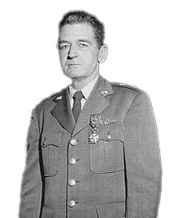
Of this great mass of reports we’ve been able to explain the great bulk of them…
However there have been a certain percentage…
By credible observers of relatively incredible things…
Gen John A. Samford

Slide 3
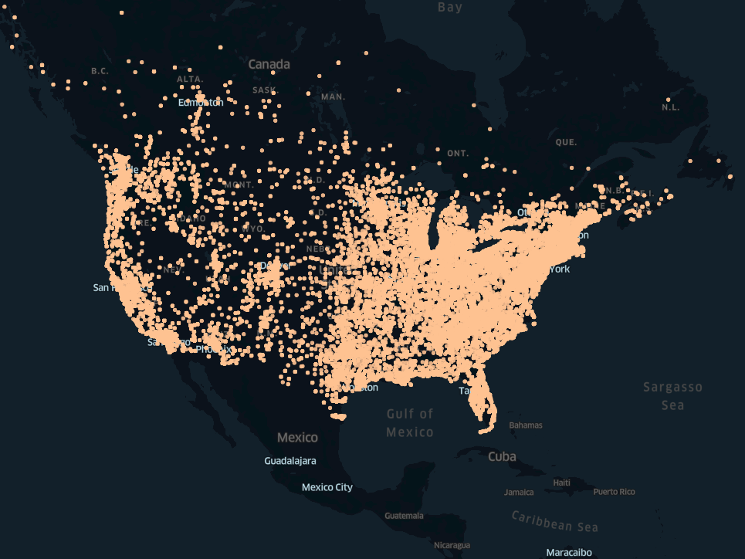

Slide 5
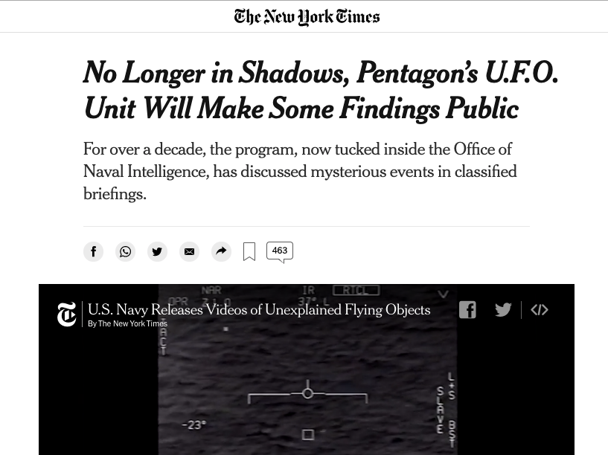

Slide 6
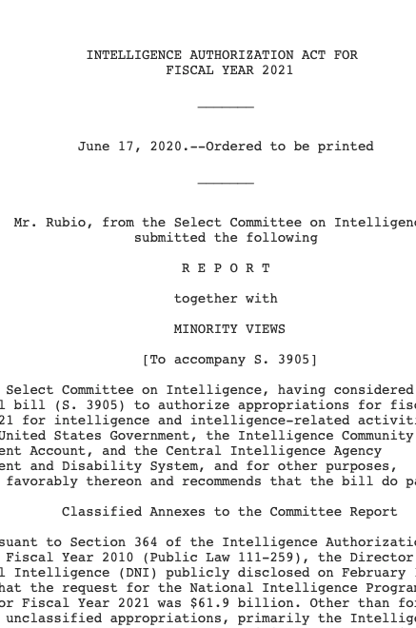
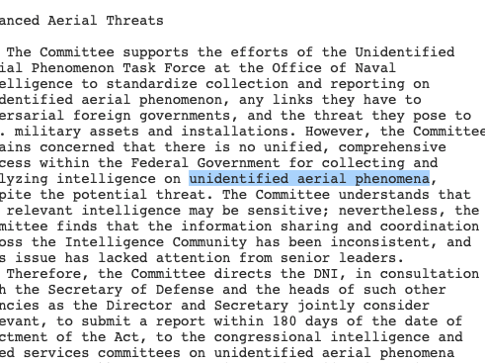
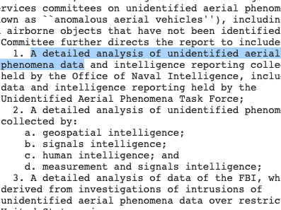

Slide 7

Tic tac ufo

Slide 8
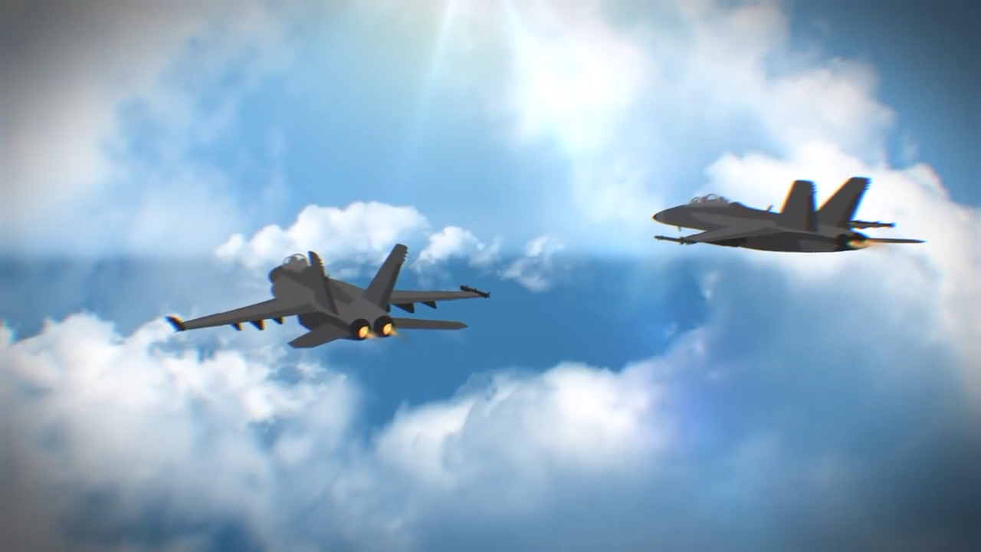
Cube ship ufo

Slide 9
Mongo fuzzy search
1st attempt
Created Mongo DB
Wrote text search queries related to the sighing e.g. “black cube or white oval”

Slide 10
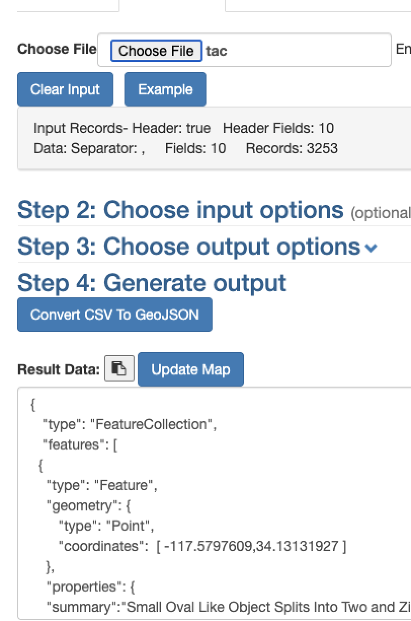
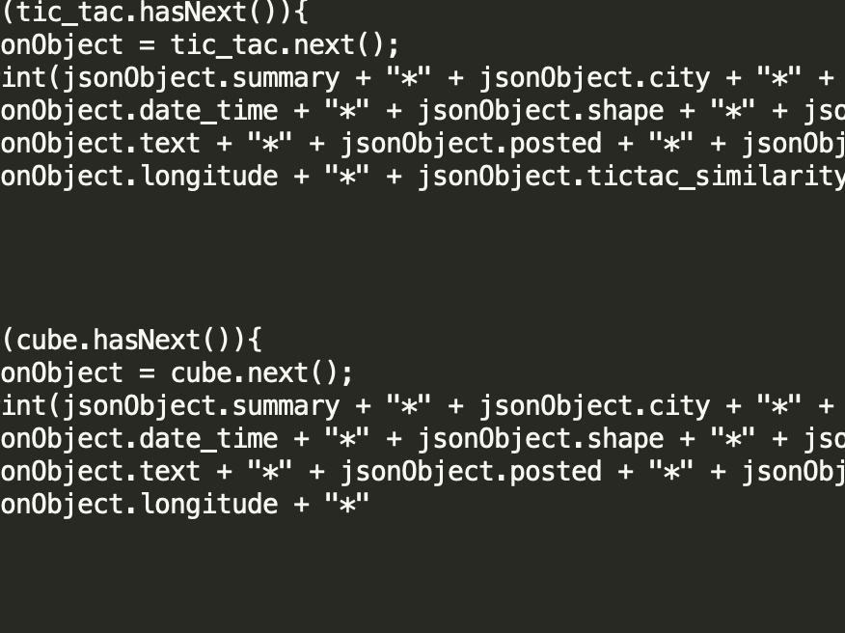
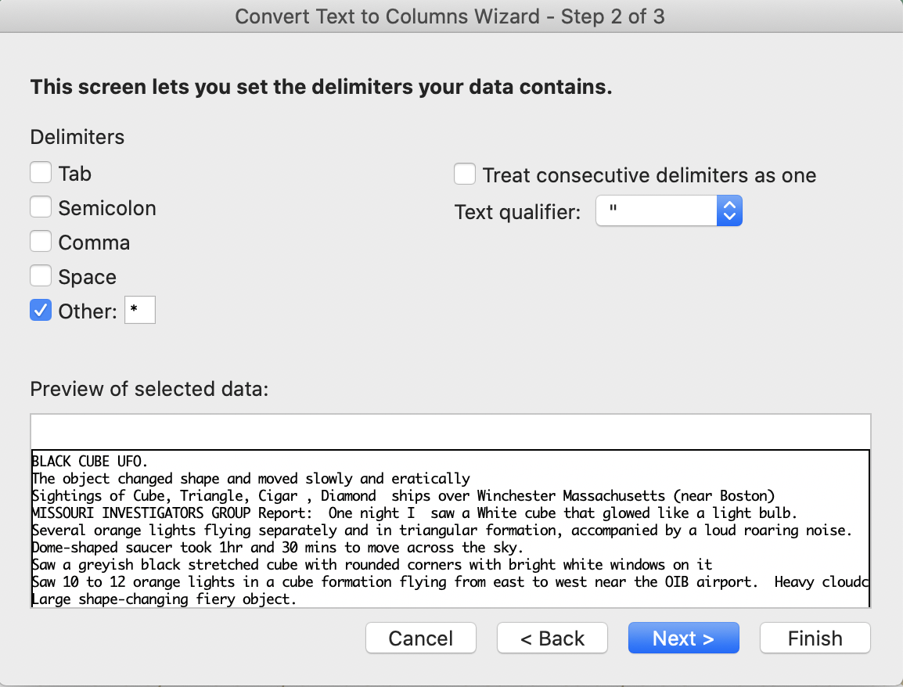

Slide 11
Natural language processing
Machine learning solution
Break sentences down into their operative words
Map similarities e.g. Target: screw driver; shovel = .6; oatmeal = 0.0
Scaling this up to entire bodies of text can derive semantic meaning

Slide 12
